Slide 1
Project: Analysis of Airbnb Data Using Power BI

Slide 2
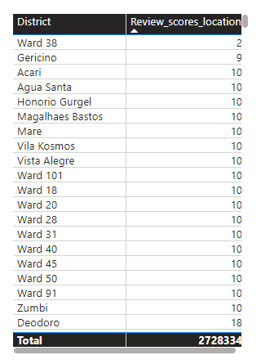
Assessing District Location Scores
The aim is to pinpoint the location in the district with the least favorable location scores.
Ward 38 In cape Town has the least favorable location scores.

Slide 3
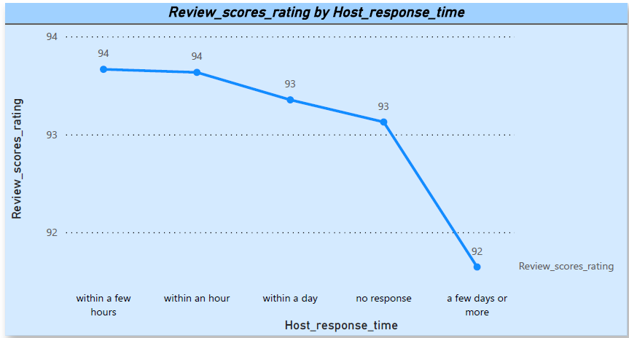
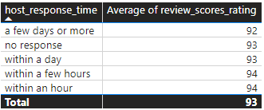
Examining Host Response Time Impact
All host response time categories have relatively high average review scores, ranging from 92 to 94. This suggests that, on average, guests tend to provide positive reviews regardless of the time it takes for the host to respond.
The small difference in average scores across response time categories (ranging from 92 to 94) indicates minimal variability in guest satisfaction based on the host's response time.
The category "no response" having an average score of 93 is interesting, given the previous observation that it had the highest sum of review scores. This could imply that, on average, guests who did not receive a response still rated their experience positively.
Summary:
while there is a subtle indication that faster response times may lead to slightly higher average review scores, the overall positive sentiment across all response time categories suggests that host responsiveness alone may not be the sole determinant of guest satisfaction. Further investigation and consideration of additional factors are crucial for a comprehensive understanding.

Slide 4
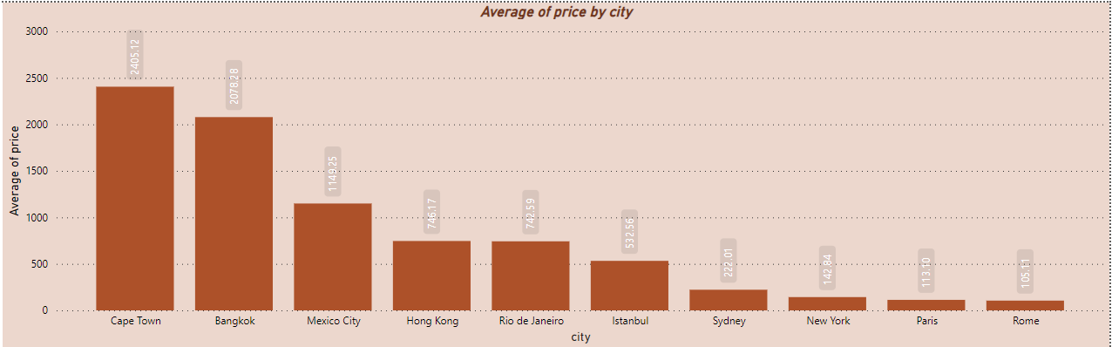
Visualizing Airbnb Listing Prices
The average listing prices vary significantly across cities, ranging from relatively high prices in Cape Town and Bangkok to more affordable options in Paris and Rome
Cape Town and Bangkok have the highest average listing prices, suggesting that these cities may generally be more expensive for Airbnb accommodations.
Cities like Mexico City, Hong Kong, and Rio de Janeiro have moderate average listing prices, offering a balance between affordability and potential amenities.
Istanbul, Sydney, New York, Paris, and Rome have lower average listing prices, making them relatively more affordable options for Airbnb stays.
Cities known for their tourist attractions, such as Sydney, Paris, and Rome, demonstrate competitive and lower average listing prices.

Slide 5
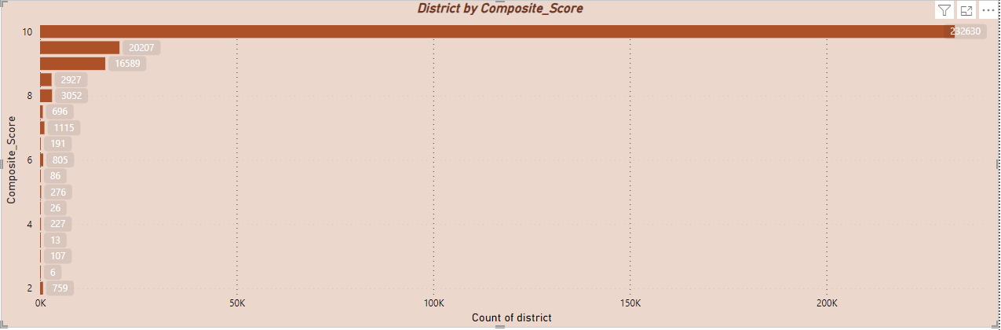
Analyzing Composite Scores
A significant number of districts across different regions consistently have a perfect composite score of 10.00. This might indicate that these districts perform exceptionally well or have similar characteristics in the evaluated criteria.
There are a few districts with slightly lower scores (e.g., 9.99, 9.98, etc.), suggesting minor variations in performance.
While many districts have perfect scores, there is a range of scores from 2.00 to 10.00, indicating diversity in the performance of different districts.
Some specific districts, like "Gericino," "Ward 16," "Ward 51," and "Ward 38," have significantly lower scores (e.g., 7.50, 6.67, 2.00). These districts might need attention or improvement.
Districts with the same score may need further investigation to understand if they are genuinely identical in performance or if there is a data quality issue.
The dataset includes districts labeled as "Ward" and others with specific names. The nature of these designations may vary based on the location and context.

Slide 6
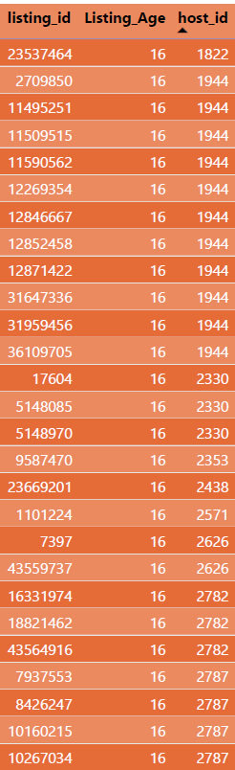
Calculating Listing Age and Host Tenure
Over 20k hosts have accumulated more than ten years of hosting expertise.

Slide 7
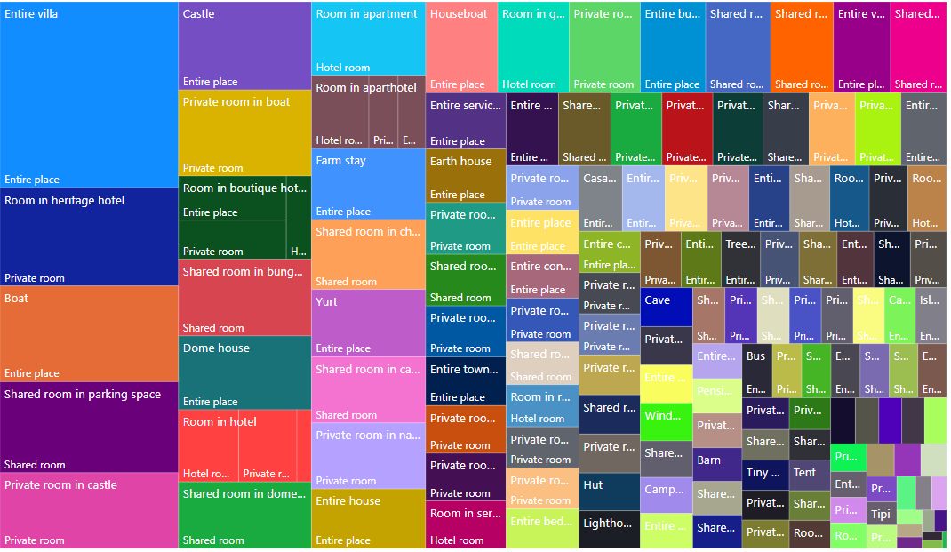
Property Type Price Analysis
The property type associated with the highest average prices for entire places is "Entire villa," with an average price of $9180.3. This implies that, on average, renting an entire villa tends to be more expensive compared to other property types in the dataset.

Slide 8
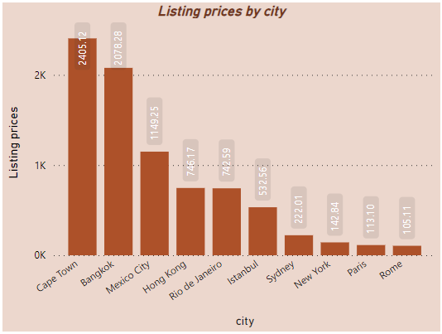
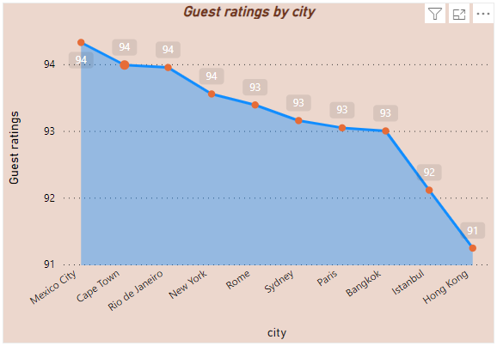
Mexico City, Cape Town, Rio de Janeiro, and New York have the highest guest ratings, all with a rating of 94. This suggests a consistent positive experience for guests in these cities.
While some cities have high and consistent guest ratings, others like Istanbul and Hong Kong have slightly lower ratings. This could be influenced by various factors, including diverse cultural expectations, accommodation standards, or other local factors.
Tourist destinations like Rio de Janeiro and Istanbul have guest ratings in the 90s, showcasing a positive experience for travelers in these popular locations.
Cape Town has the highest average listing price among the listed cities, with a value of 2405.12.
Major global cities like New York, Hong Kong, and Sydney exhibit diverse average listing prices, reflecting the different housing markets and cost of living in these cities
Tourist destinations like Rio de Janeiro and Istanbul have moderate average listing prices, making them potentially attractive for travelers seeking affordable accommodations.
European cities like Paris and Rome have comparatively lower average listing prices, indicating a relatively affordable accommodation market.
There is no column stating the date when the guests visited there respective cities. Hence was not able to perform visitor trends.

